Slide 1
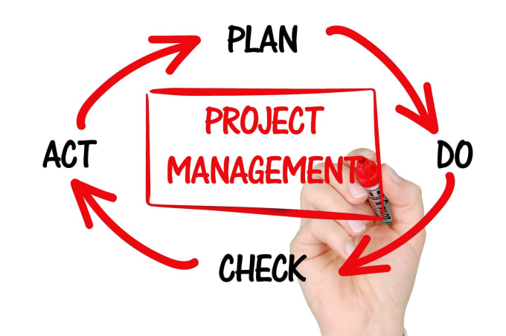

Dashboard for Task management
Efficiently Organize and Monitor Your Tasks
We are from AID Day Scholars Team 8 There are 6 members on my team we are creating the dashboard for task management INTRODUCTION * Task management is an essential process that involves Planning, Organizing, and monitoring Tasks To Ensure There Are Completed Efficiently and Effectively. The process Effectively And Efficiently Tracking, Managing & Executing And the life cycle of a task or many tasks within a project from inception to execution. BENEFITS OF TASK MANAGEMENT 1. IMPROVE PRODUCTIVITY: There is no need to have your team waste a good part of their day to attend to tasks that can be taken care of by task management or even automated.

Slide 2
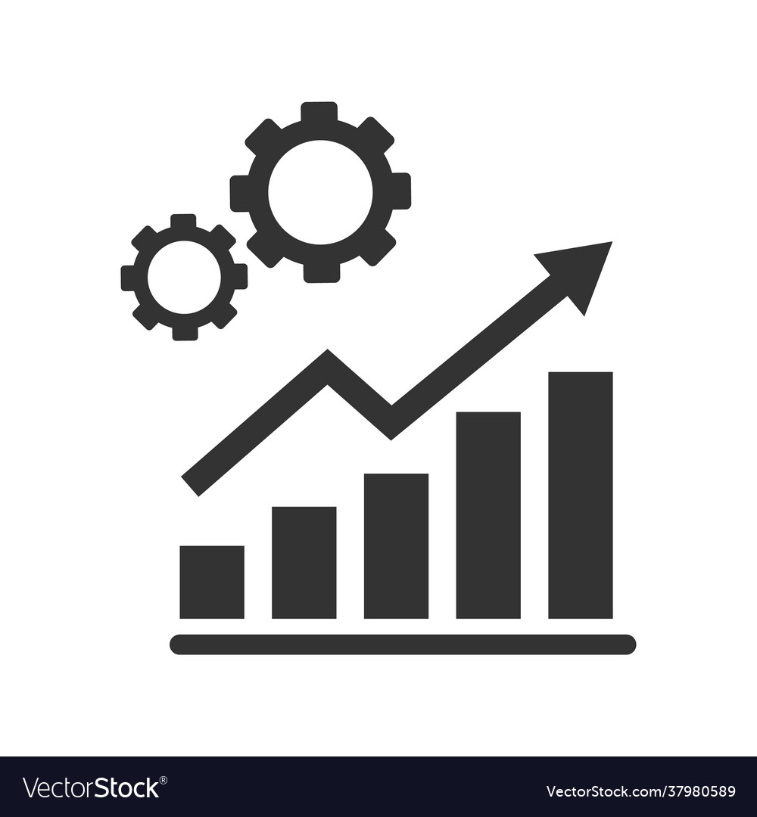

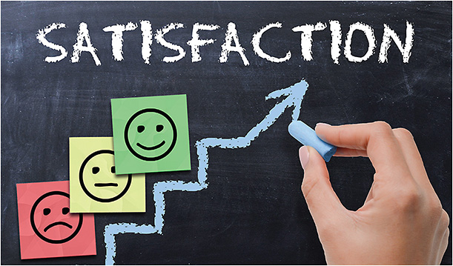

2. INCREASE EFFICIENCY: Productivity improvement will also lead to increased efficiency. That means you will be able to focus on increasing sales or attracting new clients. 3. REDUCE STRESS
The one main reason why so many businesses choose to use task management apps and systems is that doing so can tremendously reduce stress. After all, you can’t put a price on peace of mind!
4.SATISFACTION
Keeping up with all of your tasks and making sure you never miss a deadline is key to making yourself always happy.
5. MONITOR TRENDS
Task management systems allow you to easily assess and analyze statistics to determine what works and what areas might need attention. Once you are aware of the trends, you will be able to develop.

Slide 3
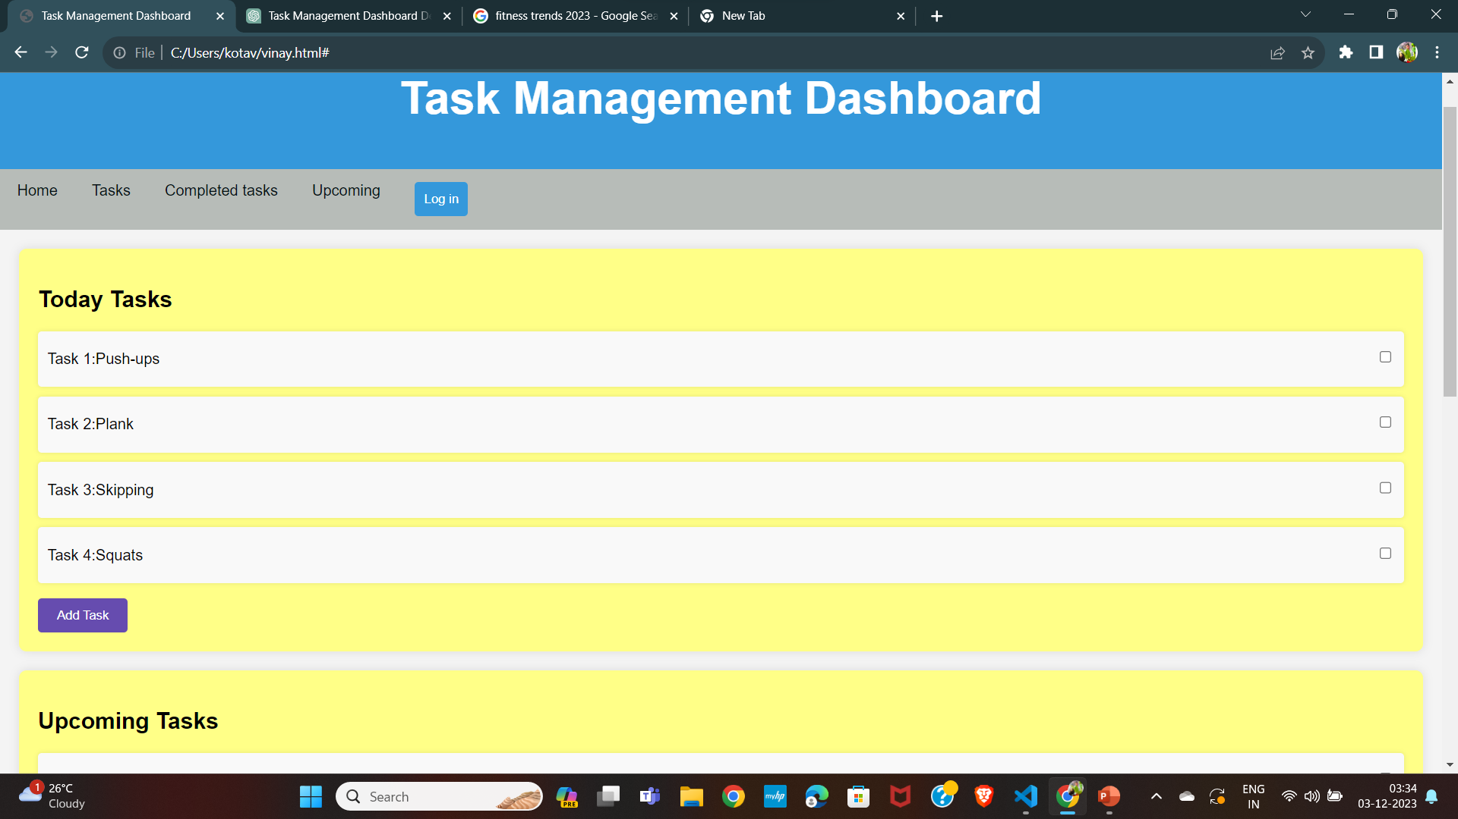

Slide 4
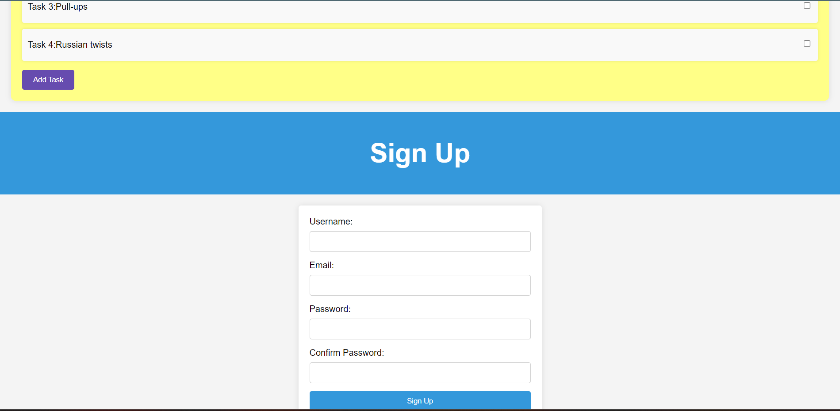

Slide 5
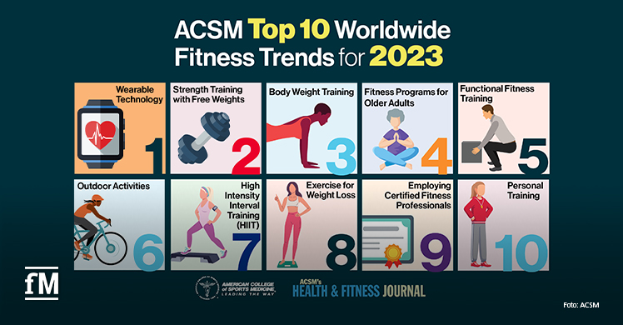

COMPONENTS OF TASK MANAGEMENT DASHBOARD : Break Down Into Sections Such As : *Tasks *Today Tasks *Upcoming Tasks *Completed tasks Conclusion:
Summarize the benefits of using the task management dashboard.
Encourage adoption and collaboration among team members.

